Slide 1
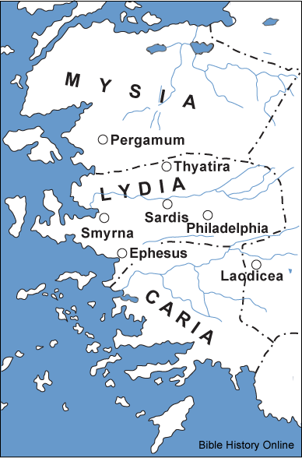
The 7 Churches of Revelation

