Slide 1
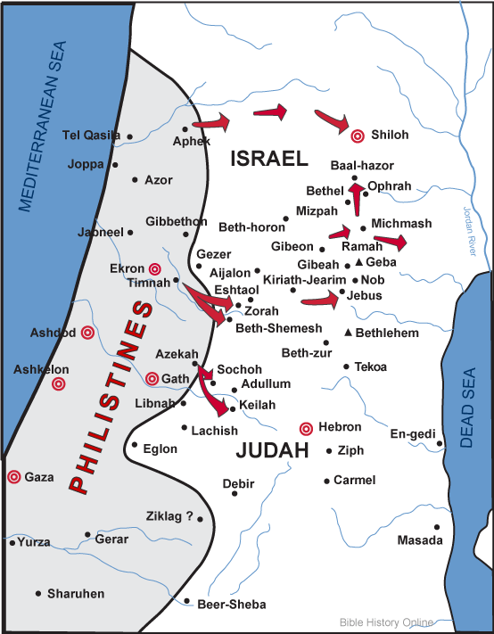
Philistine Cities and Conquests

