Slide 1
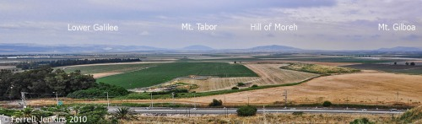
Panorama Of Jezreel Valley From Megiddo
Notes:
The Jezreel Valley lies before us to the north (and slightly east). Nazareth is located in the mountains of lower Galilee. The valley continues east between the Hill of Moreh and Mount Gilboa to Beth-Shean, the Jordan Valley, and the mountains of Gilead. The valley was known by the Greek name Esdraelon in New Testament times.
The vicinity of the Valley of Megiddo (Jezreel/Esdraelon) was the scene of many significant historical battles.
Thutmose III of Egypt fought Syrian forces – 1468 B.C.
Joshua defeated the King of Megiddo – Joshua 12:21.
Deborah and Barak defeated the Kings of Canaan – Judges 5:19.
Gideon defeated the Midianites – Judges 7.
Saul was defeated by the Philistines – 1 Samuel 28-31.
Ahaziah, king of Judah, died there – 2 Kings 9:27.
King Josiah was slain in a battle against Pharaoh Neco of Egypt – 2 Kings 23:29-30; 2 Chronicles 35:20-27.
Megiddo, the tell overlooking the valley, became typical of national grief and a symbol of decisive battles, similar to modern Waterloo, the Alamo, or Pearl Harbor. No wonder it provides the symbolism for the decisive battle in Revelation 16. John’s Greek Har-Magedon becomes the English Armageddon.
The NAU transliterates harmagedon as Har-Magedon. Other English versions use something similar to the ESV.
And they gathered them together to the place which in Hebrew is called Har-Magedon. (Revelation 16:16 NAU)
And they assembled them at the place that in Hebrew is called Armageddon. (Revelation 16:16 ESV)

