Slide 1
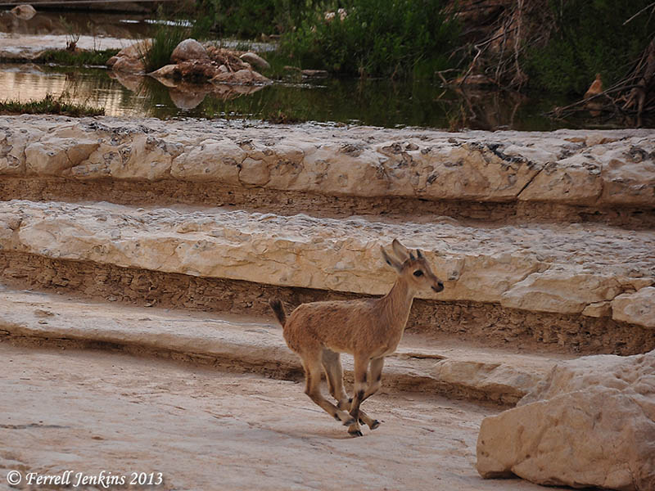
Young Ibex On The Run At En Avdat
Notes:
The “wild goats” of the Old Testament
by ferrelljenkins Wild goats (Hebrew ya’el) are mentioned in a few Old Testament passages (1 Samuel 24:2; Job 39:1; Psalm 104:18; Prov. 5:19). This animal is often identified with the Ibex.
The ibex, a type of wild goat, is still found in Southern Palestine, Sinai, Egypt and Arabia; it was known also in ancient times, as is evident from rock carvings. (Fauna and Flora of the Bible, 46).
The wild goats are associated with En Gedi on the shore of the Dead Sea.
Now when Saul returned from pursuing the Philistines, he was told, saying, “Behold, David is in the wilderness of Engedi.” Then Saul took three thousand chosen men from all Israel and went to seek David and his men in front of the Rocks of the Wild Goats. (1 Samuel 24:1-2 NAU)
The Ibex may also be seen at En (Ein) Avdat (Avedat) and Mitzpe Ramon in Israel. The photo below shows one of the young Ibex on the run at En Avdat

Slide 2
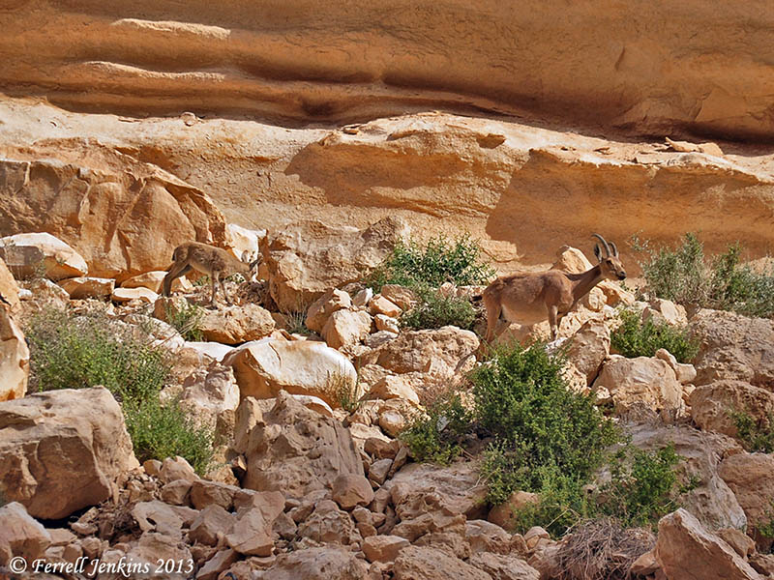
Ibex At En Avdat in the Wilderness of Zin
Notes:
This photo illustrates how well the Ibex blend in with the terrain in which they live.

Slide 3
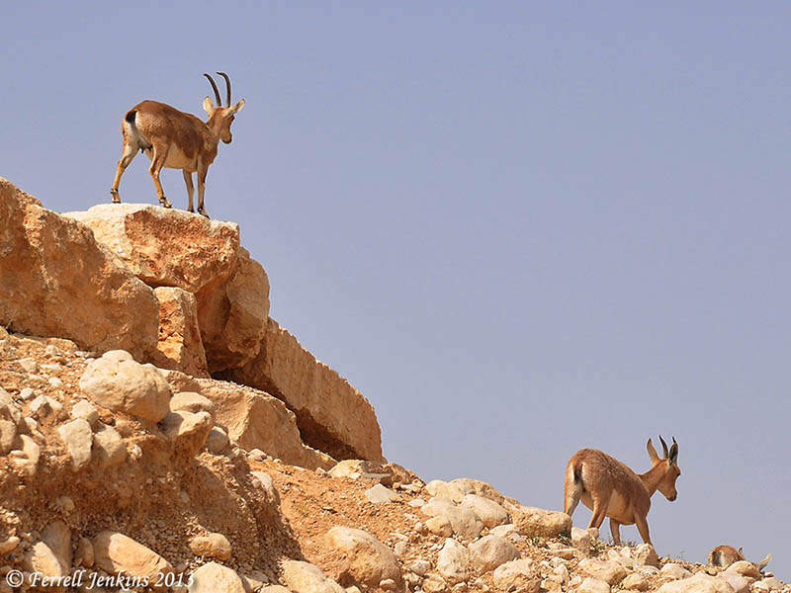
Ibex In The wilderness of Zin Near En Avdat
Notes:
The last photo shows the sure-footed Ibex seeking out the high places.
The reference to the hind or deer (Hebrew ayyalah) in Psalm 18:33 (Hebrew 18:34) indicates a different species, but the analogy is the same. Both Hebrew terms are used in Job 39;1.
He makes my feet like hinds' feet, And sets me upon my high places. (Psalm 18:33 NAU)
He gives me the agility of a deer; he enables me to negotiate the rugged terrain. (Psalm 18:33 NET)
If you would like to see another photo of the Ibex at En Gedi, click here.

