Slide 1
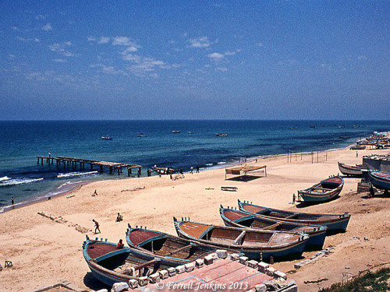
Gaza on the Mediterranean Sea in May, 1968
Notes:
The significance of Gaza
by ferrelljenkins
After my first tour to the Bible Lands, including Rome, Greece (Athens and Corinth), Egypt, Lebanon, Syria (Damascus), Jordan, and Israel, in April/May, 1967, I decided to make a second tour the following year. For many years, I always added some new places on each tour. In 1968 I added Beersheba and Gaza. The Gaza Strip (named such because of the long, narrow size of the small entity) had been under Egyptian control for several decades until June, 1967.
There was not much to see at Gaza. By the time we visited in 1968, Gaza was under Israeli control. We drove to the coast where there were only a few houses and some small fishing boats. This is one of the few slides that I have to illustrate the visit to Gaza.

Slide 2
Gaza on the Mediterranean Sea in May, 1968
Notes:
Gaza is mentioned several times in the Old Testament. Here is a summary of these references.
Gaza was the southwestern boundary of the Canaanites in the table of Nations (Genesis 10:19).
The original inhabitants of Gaza were replaced by the Caphtorim, likely the ancestors of the Philistines (Deuteronomy 2:23).
Joshua defeated Canaanites "even as far as Gaza" (Joshua 10:41).
Joshua eliminated the Anakites except in Gaza, Gath, and Ashdod (Joshua 11:21-22). We recognized these cities as later belonging to the Philistines.
Gaza is listed as belonging to the tribe of Judah (Joshua 15:47; Judges 1:18).
The Midianites oppressed Israel, "as far as Gaza", for seven years (Judges 6:4).
Samson had contact with the inhabitants of Gaza (Judges 16).
Gaza is listed as one of the five Philistine cities in the time of the Israelite Judges (1 Samuel 6:17).
Solomon controlled territory as far southwest as Gaza (1 Kings 4:24).
Hezekiah defeated the Philistines as far as Gaza and its territory (2 Kings 18:8).
Jeremiah makes reference to Gaza being conquered by Pharaoh (Jeremiah 47:1).
The prophets of Judah pronounced judgments upon Gaza (Amos 1:6-7; Zephaniah 2:4; Zechariah 9:5).
The only New Testament reference to Gaza is in Acts 8:26. Philip the evangelist was instructed to go south on the road that descends from Jerusalem to Gaza. English translators struggle with the issue of whether the city was desert, or the road leading to the city ran through a desert area. (I will leave that for some other time.)
The first display one sees as he enters the archaeology wing of the Israel Museum is that of the anthropoid coffins from Deir el-Balah, a site south of Gaza city. The coffins, excavated by Trude Dothan in 1972, bear evidence of Egyptian influence. They date to the 13th century B.C.

Slide 3
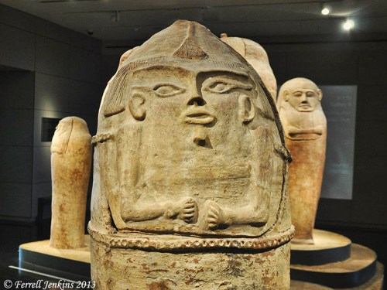
Anthropoid Coffins from Deir el-Balah in the Israel Museum
Notes:
The first display one sees as he enters the archaeology wing of the Israel Museum is that of the anthropoid coffins from Deir el-Balah, a site south of Gaza city. The coffins, excavated by Trude Dothan in 1972, bear evidence of Egyptian influence. They date to the 13th century B.C.

