Slide 1
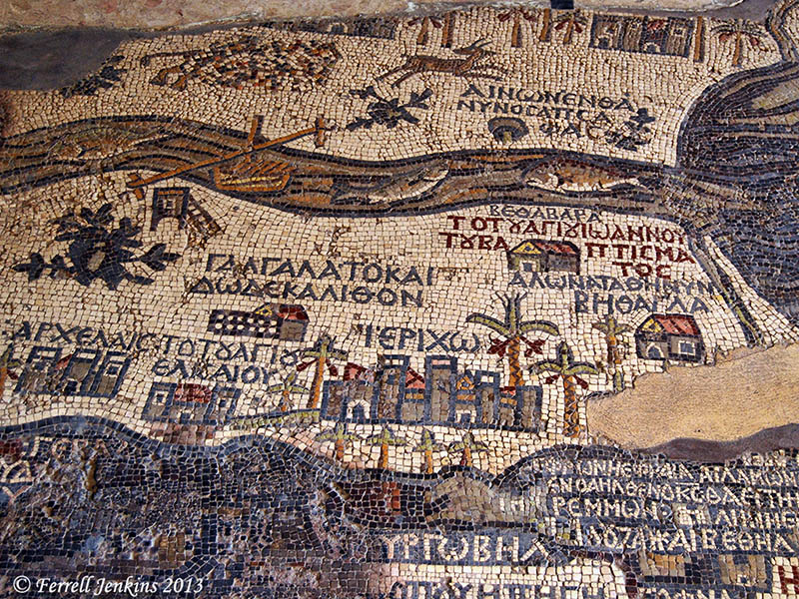
Portion of the Madaba Map Mentioning Ephron
Notes:
More about Ephraim
by ferrelljenkins
In the previous post we pointed out that Ephraim, where Jesus went a short time before His death (John 11:54), is identified with Taybeh on the edge of the wilderness.
Ephraim is included on the Madaba Map dating to about 560-565 A.D. Below is a photo of a portion of the Madaba Map. The large town with palm trees around it represents Jericho. Below Jericho the land color changes to black. The entry closest to Jericho, but a little to the right, is Ephraim.
According to the website dealing with The Madaba Map, provided by the Studium Biblicum Franciscanum – Jerusalem, the two lines of white lettering read,
Ephron also Ephraia, where went the Lord

Slide 2
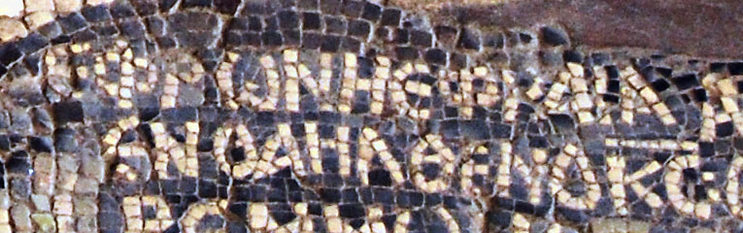
Closeup of the Ephron Reference in Madaba Map
Notes:
Here is a larger cropped portion of the map identifying Ephron. If your Byzantine Greek is up to date, you can make out all of the words.
The inscription is located close to the wilderness, but is too far south. Other similar mistakes are made on the map. One such example would be the location of Ebal and Gerizim (See Victor R. Gold. "The Mosaic Map of Madaba." Biblical Archaeologist, Sept. 1958: 50-71).
Ruins of a Byzantine church remain at Taybeh. There are also Crusader ruins. The Madaba Map from Jordan reflects the traditions of the 6th century A.D. Add this to the biblical evidence we mentioned equating Ephron, Ophrah, and Ephraim, and we have strong evidence that Taybeh marks the site of Ephraim.
Barry Britnell pointed out that Google Maps spell the name of Taybeh as Taibe.
You may read more about the Madaba Map section on Ephron here. Click on Ancient Sources for quotations from Eusebius and Josephus. Also check the Discussion section for more explanation.
William F. Albright suggested, as early as 1924, that Ephraim was to be identified with En Samye (Ein Samiyeh), a few miles northeast of Taybeh. Well, that gives me another place to visit in the future.

Slide 3
Closeup of the Ephron Reference in Madaba Map
Notes:
Jesus withdrew to Ephraim
by ferrelljenkins
The raising of Lazarus of Bethany brought much attention to Jesus and His ministry (John 11). According to John's account, beginning in verse 45, many who saw the sign believed on Him. This caused the chief priests and Pharisees to convene a council. They were concerned about what the Romans might do if Jesus continued His work. Caiaphas, the high priest that year, told the council that it would be better for one man to die than for the whole nation to perish. In fact, John says this was a prophecy that Jesus was going to die for the nation. The text says,
So from that day on they made plans to put him to death. (John 11:53 ESV)
Jesus had other plans. Jesus carefully orchestrated His death. From the beginning of His ministry He spoke of His hour. After the raising of Lazarus he withdrew to a place northwest of Jerusalem on the edge of the wilderness at Ephraim.
Jesus therefore no longer walked openly among the Jews, but went from there to the region near the wilderness, to a town called Ephraim, and there he stayed with the disciples. (John 11:54 ESV)
Jesus would offer Himself as the sacrificial lamb at the time of the Passover. This took intricate planning.

Slide 4
Closeup of the Ephron Reference in Madaba Map
Notes:
Where is this place called Ephraim?
The identity of this place is complicated, partly because of the obscurity of the place and because of the change of names in the various languages that have prevailed in the territory over the centuries. Let's try to work through some of the details.
Baal-hazor, where Absalom had sheep shearers, is said to be near Ephraim (2 Samuel 13:23).
The Ephron of 2 Chronicles 13:19 is often identified with Ephraim and the Ophrah of Joshua 18:23. Ophrah was in the tribal territory of Benjamin and near Bethel. Ophrah, which we are equating with Taybeh (tie-BAY), is only 4 miles north-east of Bethel and about 15 miles from Jerusalem.
What is the name of Ephraim today? Ephraim is often identified with a Christian Arab town in the West Bank Palestinian territory known as At-Taybe. On Highway 60 a sign points to Taybeh, the spelling I am using. Carta's Israel Touring Atlas spells it Et-Tayibeh.
Checking the Maps. Taybeh should be reached easily from Highway 60 by taking Highway 449 east at Ofra, and then a smaller road to the village. This is not possible. Ofra is an Israeli settlement, and the road is blocked for those wishing to go to Taybeh. Instead, it is necessary to take Highway 457 east, then 458 north. At the intersection with 449 (east), take the small road to the left to reach Taybeh. Highway 449 leads to the Jordan Valley and Jericho. The paved road is only wide enough for one vehicle at places and is in bad repair.

