Slide 1
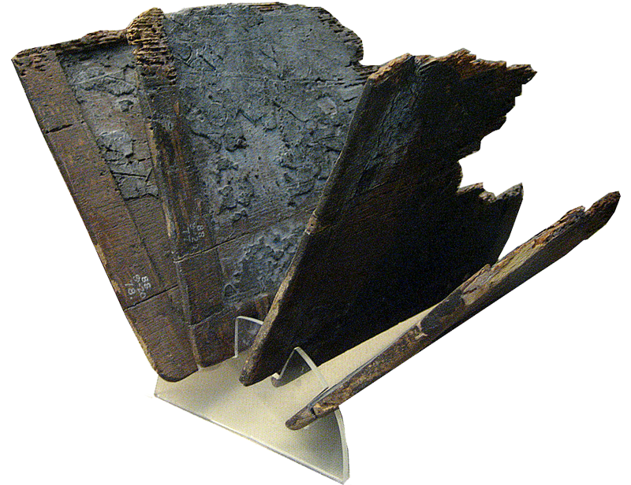
Tablet (Roman Period From Egypt)
Notes:
Zacharias asked for a writing tablet
by ferrelljenkins
When John was born, the neighbors and relatives thought they would call the child "Zacharias, after his father." His mother, Elizabeth, said that he should be called John. The guests made signs to the mute Zacharias to have him say what he wanted the child called. Luke says,
He asked for a writing tablet and wrote, "His name is John." And they were all amazed. (Luke 1:63 NET)
The Greek word Luke used for tablet is pinakidion. It is used only here in the New Testament. BDAG Lexicon says the term is used of a "little (wooden) tablet esp. of a writing-tablet for notes." Louw-Nida says the word describes "a small writing tablet (normally made of wood)." The Study Note in the NET Bible points out that "The writing tablet requested by Zechariah [Zacharias] would have been a wax tablet."
Ralph Earle comments on the tablet:
It was a wax-coated, small, wooden "writing tablet" (NIV)—something quite different from a "writing table" (KJV). — Word Meanings in the New Testament.
A little insight into the culture of the time makes the Bible come alive.
Origen, c. 185–c. 254, comments on this verse in his Commentary on Matthew Bk. XIII.

